Slide 1



ReadVine
WELCOME
Book Recommendation App
By Adil Ijaz
Khaleeque Ahmed
Muhammad Yousif
Muhammad Zaheen
DBMS
Project

Slide 2

ReadVine
Book Recommendation App
By Adil Ijaz
Khaleeque Ahmed
Muhammad Yousif
Muhammad Zaheen
DBMS
Project

Slide 3

Introduction
Objective
To create an interactive desktop app that helps users discover, view, and save books using:
A clean CustomTkinter UI
Real-time Open Library API
MySQL database for saved favorites

Slide 4
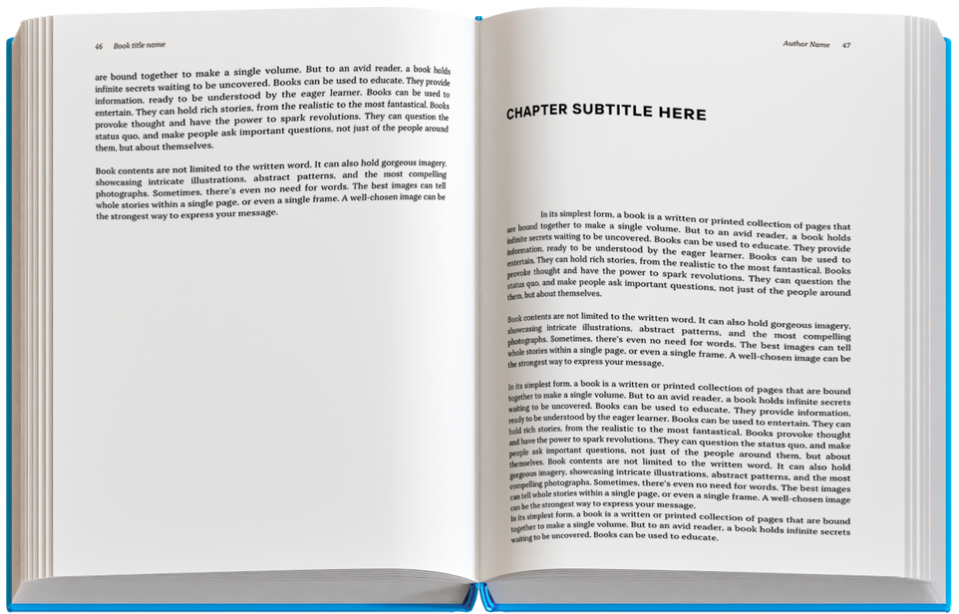
Tech Stack
01
Frontend
CustomTkinter (themed Tkinter)
02
Backend API
Open Library API (RESTful)
03
Image Processing
Pillow (PIL)
04
Database
MySQL Connector

Slide 5

Features
The Book Recommendation App is packed with user-friendly features to enhance your reading journey, from real-time book search to personalized favorites, it combines functionality with a sleek interface. Explore, save, and revisit your favorite books—all in one modern, intuitive platform.
🔍 Search for Books (Real-Time API)
📖 View Detailed Information
❤️📂 Favorites Management
Book Cover (via Open Library cover API)
Title and Author(s)
Short Description (fetched from the book's OLID using Works API)
Description is truncated after 150 characters for readability
Users can type any keyword (title, author, genre, etc.)
App sends a request to the Open Library API
Returns a list of matching books instantly
Displays top 8 relevant results to avoid clutter
Users can click "❤ Add to Favorites"
Saves selected book details into MySQL database
"View Favorites" button retrieves all saved books
Stored books are displayed in the same card layout
Allows offline access to previously saved books

Slide 6

Database Design
The database uses a simple MySQL table named favorites with fields for book details (title, author, cover ID, description, and Open Library ID). It enables persistent storage of user-selected books with auto-incremented IDs as primary keys. The schema focuses on efficiency for basic CRUD operations without complex relationships. Error handling ensures reliable database connectivity and data integrity
Table Name: favorites
Fields:
id (Primary Key)
title (Book title)
author (Book author)
cover_id (Open Library cover ID)
description (Book description)
olid (Open Library ID for future reference)

Slide 7




API Integration
Open Library Search API:
Endpoint: https://openlibrary.org/search.json?q={query}
Returns list of books
Work API for description:
Endpoint: https://openlibrary.org/works/{olid}.json
Covers:
URL: http://covers.openlibrary.org/b/id/{cover_id}-M.jpg

Slide 8


User Interface
01
02
Modern Dark Theme
Components
Clean, responsive layout with customtkinter.
Search bar with entry and buttons.
Scrollable recommendations frame.
Book cards with cover images and metadata.
"Add to Favorites" button for each book.

Slide 9
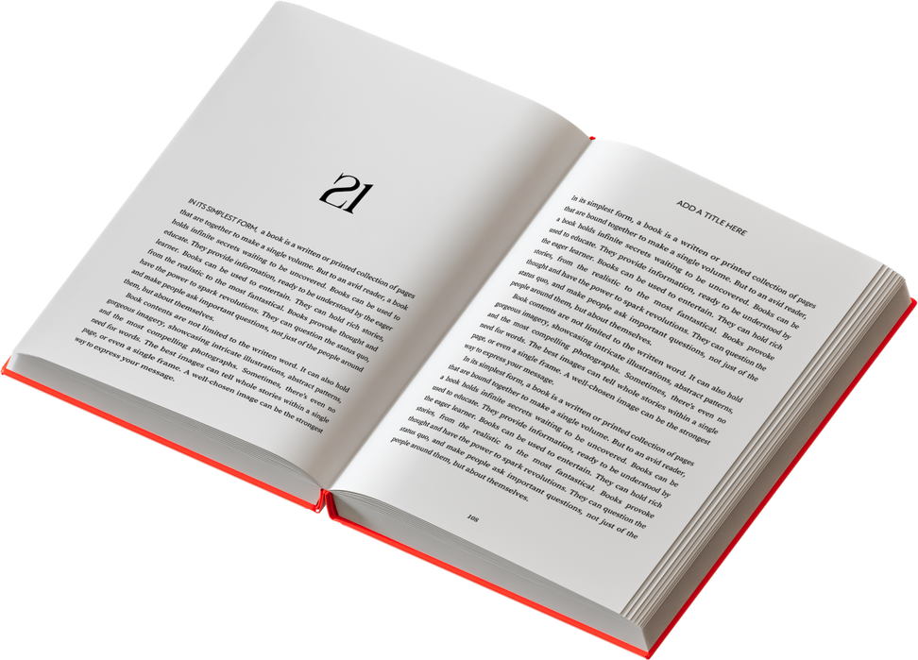
Challenges & Solutions
Challenge | Solution
Missing book descriptions | Handled with fallback logic
API rate-limiting | Added result limits
UI alignment issues | Used consistent frame layout
Duplicate favorites | Check before insert

Slide 10
THANK YOU

